Slide 1









Presentasi
TIM INFO KOPI
INACOMP 1.0

Slide 2
Pencapaian yang sudah dilakukan : 1. Case 1 : soal, masalah, solusi, belum verifikasi
2. Case 2 : soal, masalah, solusi, berhasil verifikasi
3. Case 3 : soal, masalah, solusi, belum verifikasi
4. Case 4 : soal, masalah, solusi, berhasil verifikasi
5. Case 5 : soal, masalah, solusi, berhasil verifikasi
6. Case 6 : soal, masalah, solusi, berhasil verifikasi
7. Case 7 : soal, masalah, solusi, berhasil verifikasi

Slide 3

Case 1
SOAL
There is a problem with the VOICE networks. Somehow all IP Phone does not call each
other it's better to check right now, what happened, and fix it
Masalah
Switchport masi dalam mode akses

Slide 4
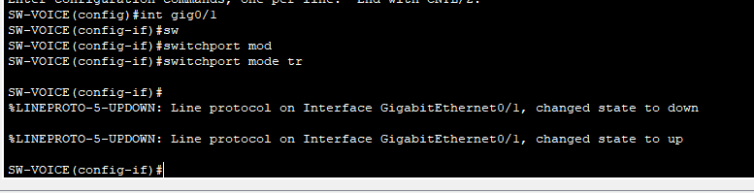
SOLUSI CASE 1
Interface dari switch ke router diubah menjadi mode trunk

Slide 5
VERIFIKASI CASE 1
TIDAK ADA

Slide 6
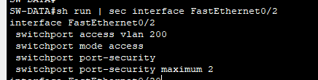
Case 2
SOAL
Please check to make sure that only Admin-PC can connect to his switch, don't let another PC use that port.
Masalah

Slide 7
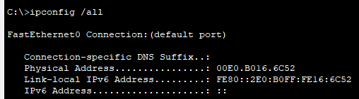
SOLUSI CASE 2
Menambahkan mac address pc ke port security

Slide 8
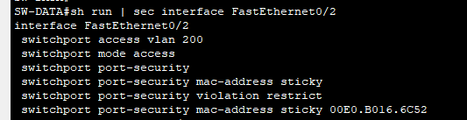
VERIFIKASI CASE 2
Mac address pc sudah terdaftar di port security

Slide 9
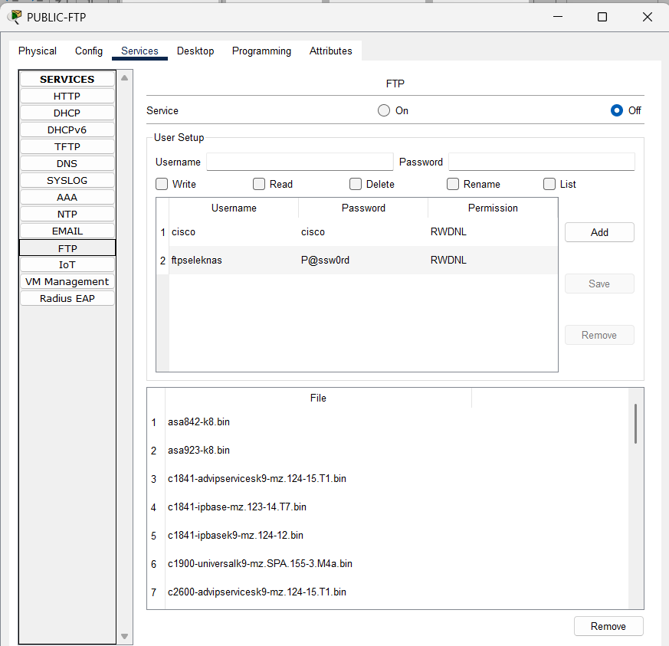
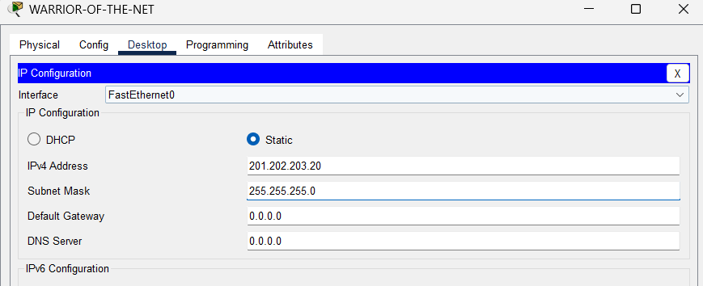
Case 3
SOAL
Warrior of the Net can't access Public-FTP.
Masalah

Slide 10
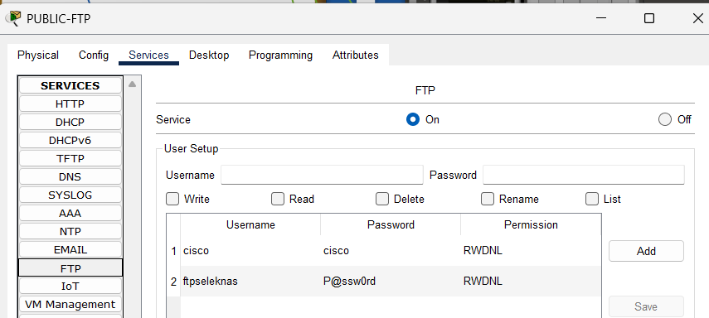
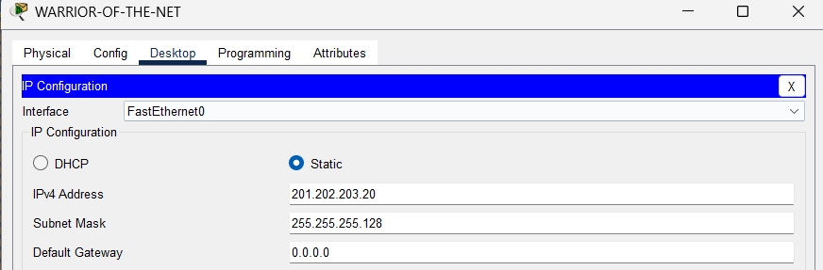
SOLUSI CASE 3
Menyalakan layanan ftp di public ftp dan mengganti subnet mask warrior of the net

Slide 11
VERIFIKASI CASE 3
TIDAK ADA

Slide 12
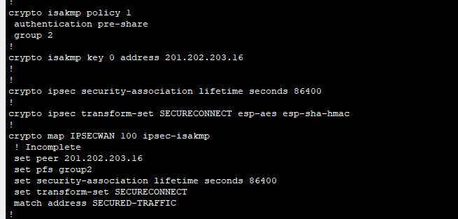

Case 4
SOAL
The communication between APP1 servers & APP2 servers must be encrypted (AES), some
configurations were configured, but currently don't work, please complete making it work.
Masalah (app r1)

Slide 13
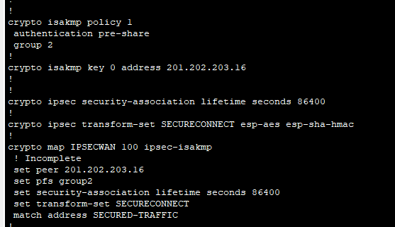

Case 4
SOAL
The communication between APP1 servers & APP2 servers must be encrypted (AES), some
configurations were configured, but currently don't work, please complete making it work.
Masalah (app r2)

Slide 14



SOLUSI CASE 4
Menambahkan Crpyto map IPSECWAN pada interface Fa0/0 di APP2-RTR, dan menambahkan informasi access-list di kedua router

Slide 15
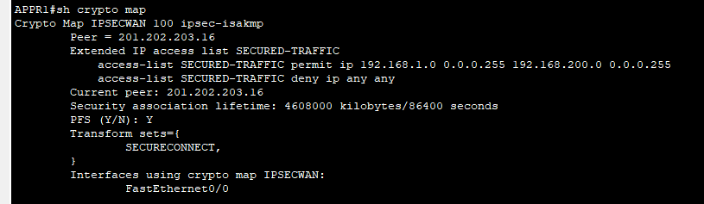
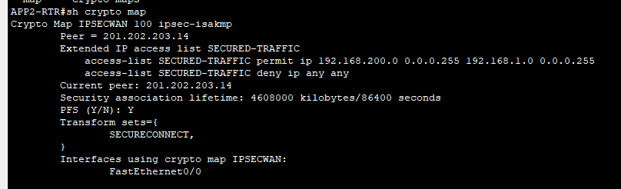
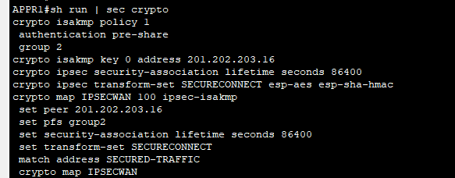
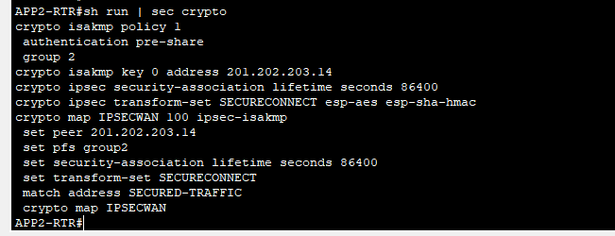
VERIFIKASI CASE 4
Sudah tidak ada tulisan !incomplete

Slide 16
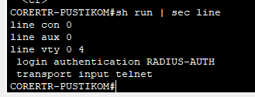

Case 5
SOAL
Warrior of the Net can't SSH access to the CORERTR and it should always authenticate the
centralized server.
Masalah

Slide 17

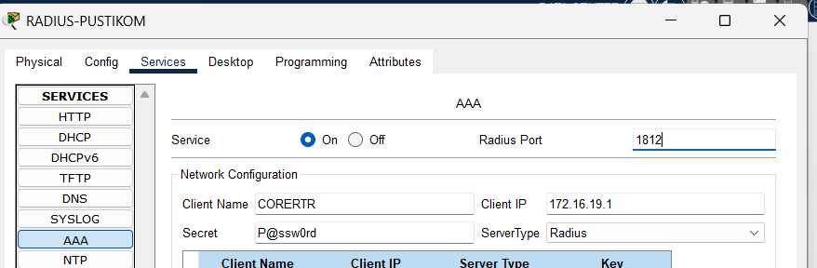
SOLUSI CASE 5
Mengubah transport input menjadi ssh dan mengubah port AAA menjadi 1812

Slide 18
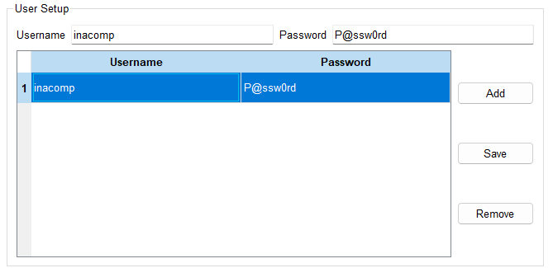
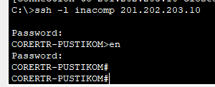
VERIFIKASI CASE 5
Ssh dengan user dan password yang disediakan

Slide 19
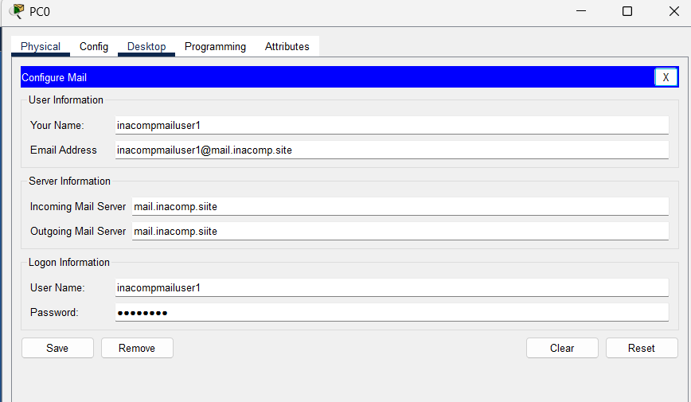
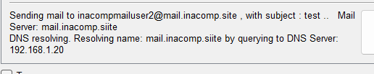
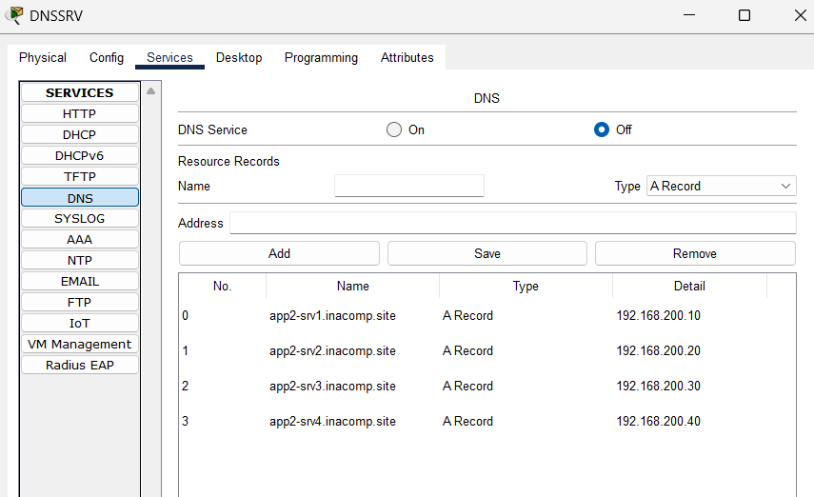
Case 6
SOAL
After some system migration, currently, the MAIL Server does not work also. Please spot the
server and test in the PC client.
Masalah

Slide 20
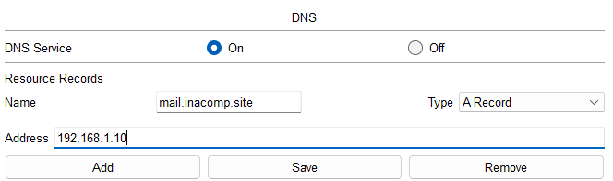
SOLUSI CASE 6
Menambahkan DNS Record dan membenarkan incoming & outcoming mail server pada PC0

Slide 21
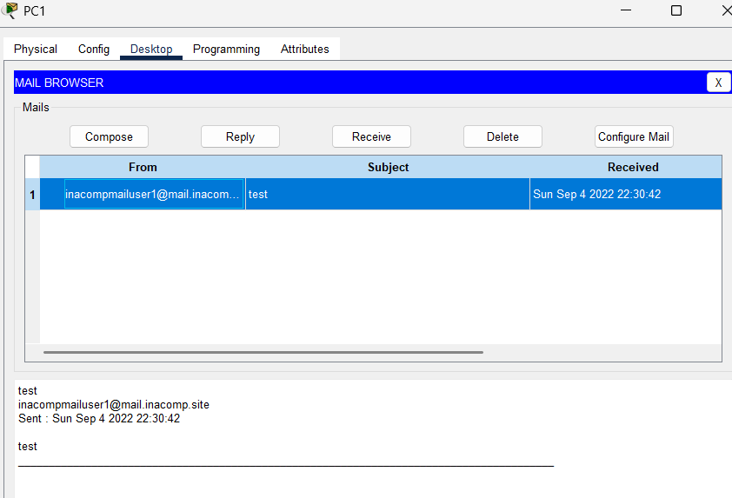
VERIFIKASI CASE 6
Mengirim test mail antar client

Slide 22
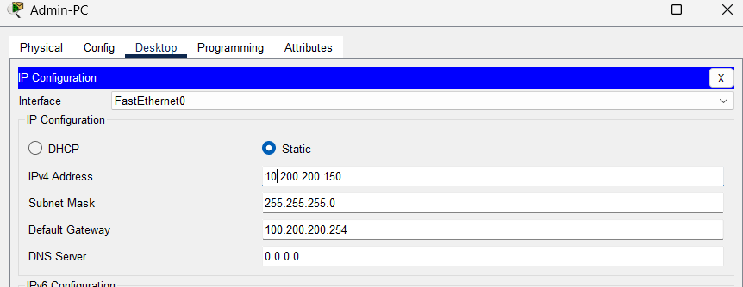


Case 7
SOAL
There is an issue also with High Availability on NAT-Gateway. Make sure the IP address
10.200.200.254 can be used for HA.
Masalah

Slide 23
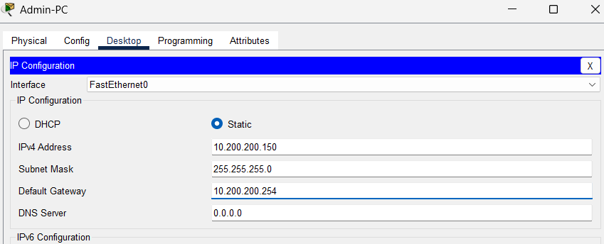
SOLUSI CASE 7
Menambahkan konfigurasi di interface gig0/0.200 dan standby

Slide 24
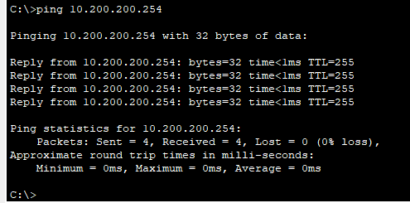
VERIFIKASI CASE 7
Ping dari PC ke IP Virtual

Slide 25

TERIMA KASIH

